Slide 1

Image Compression Based on Non-Parametric Sampling in Noisy Environments
Kishan Narotam Nitesh Nana
Supervisor: Professor Fambirai Takawira

Slide 2
Why?
Research-based
Potential new method for image compression
Current schemes:
DCT → JPEG
DWT → JPEG-2000

Slide 3
Outline
Objectives and Specifications
System Overview
System Implementation
Results & Analysis
Future Work
Conclusion

Slide 4
Objectives and Specification
Create a robust image compression scheme
Create holes in the image
Encode the image
Introduce random errors
Filling the holes
Time frame: 6 weeks
Budget: R1 200
Notes:
Objective -> Robust scheme
Broken into the main tasks of: …

Slide 5
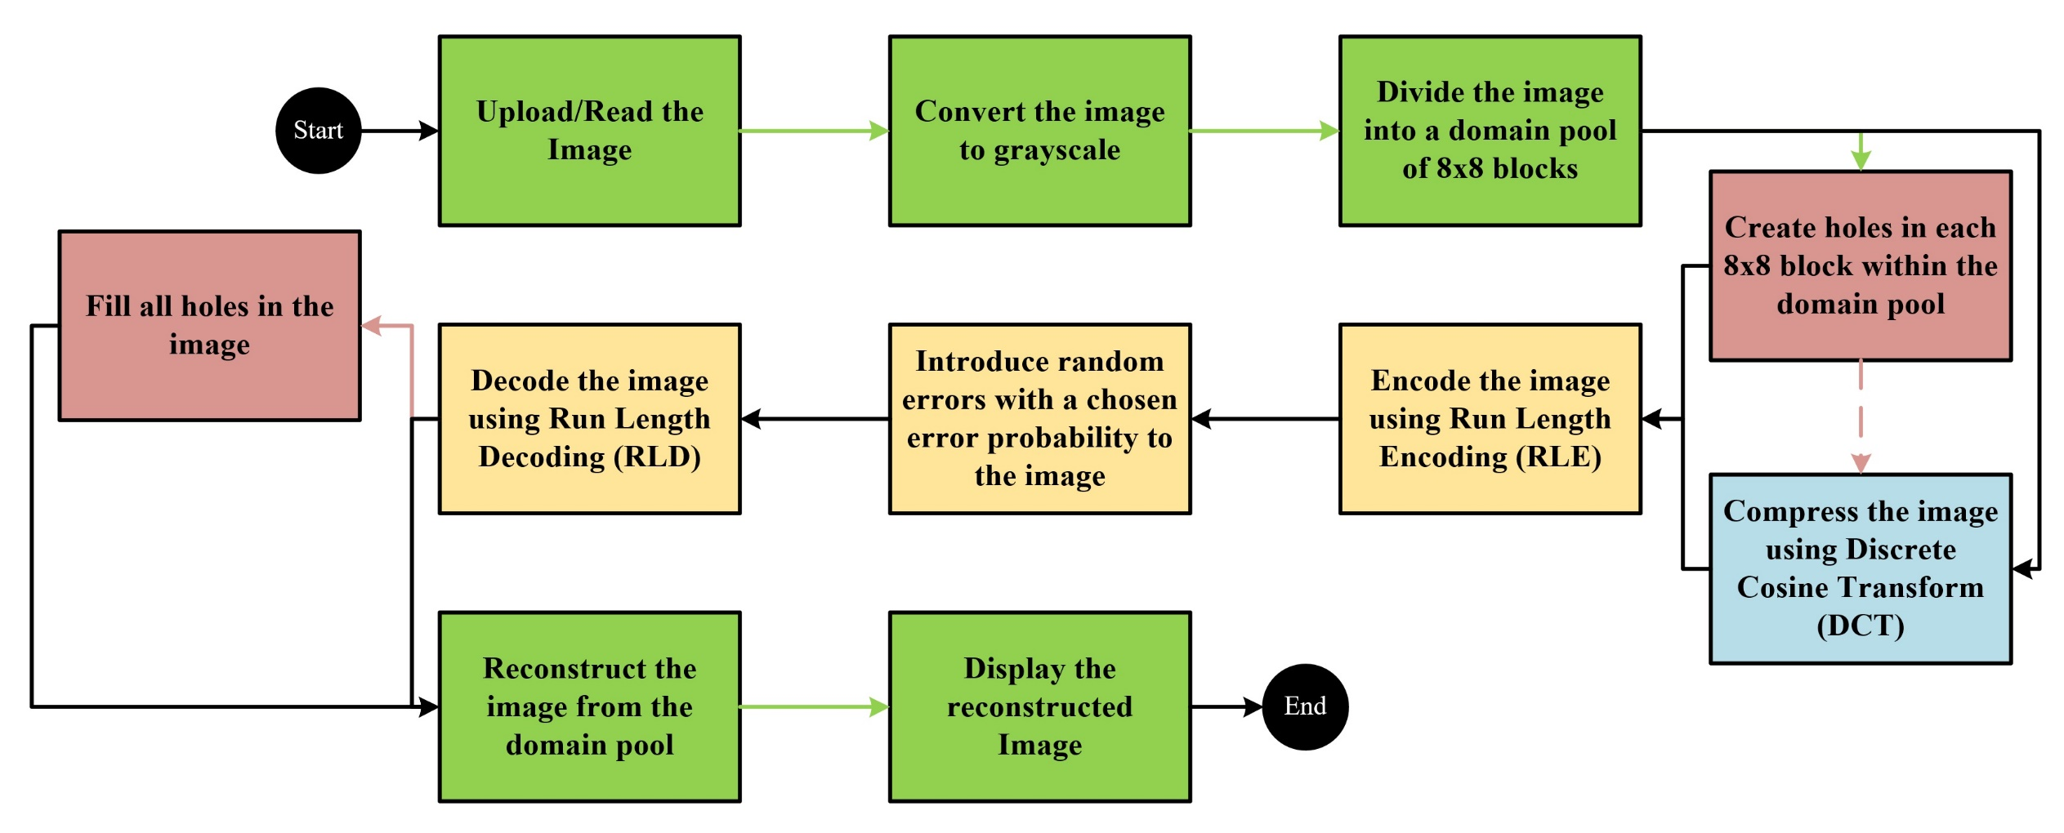
System Overview
Notes:
Green present -> displaying and storing the image
Red present -> Creating and filling holes
Orange presents -> channel
Blue presents -> known technique, higher compression, higher complexity
3 schemes seen:
Holes only
DCT only
Holes+DCT

Slide 6
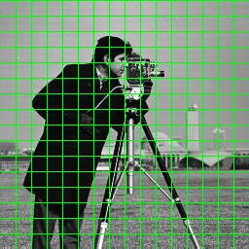
System Implementation (Initial Steps)
Reading an image:
Height
Width
Colour map
8-bit unsigned integers
Converting to grayscale:
Height
Width
Create the domain pool
Notes:
Colour map -> RGB
Grayscale -> averages out RGB

Slide 7
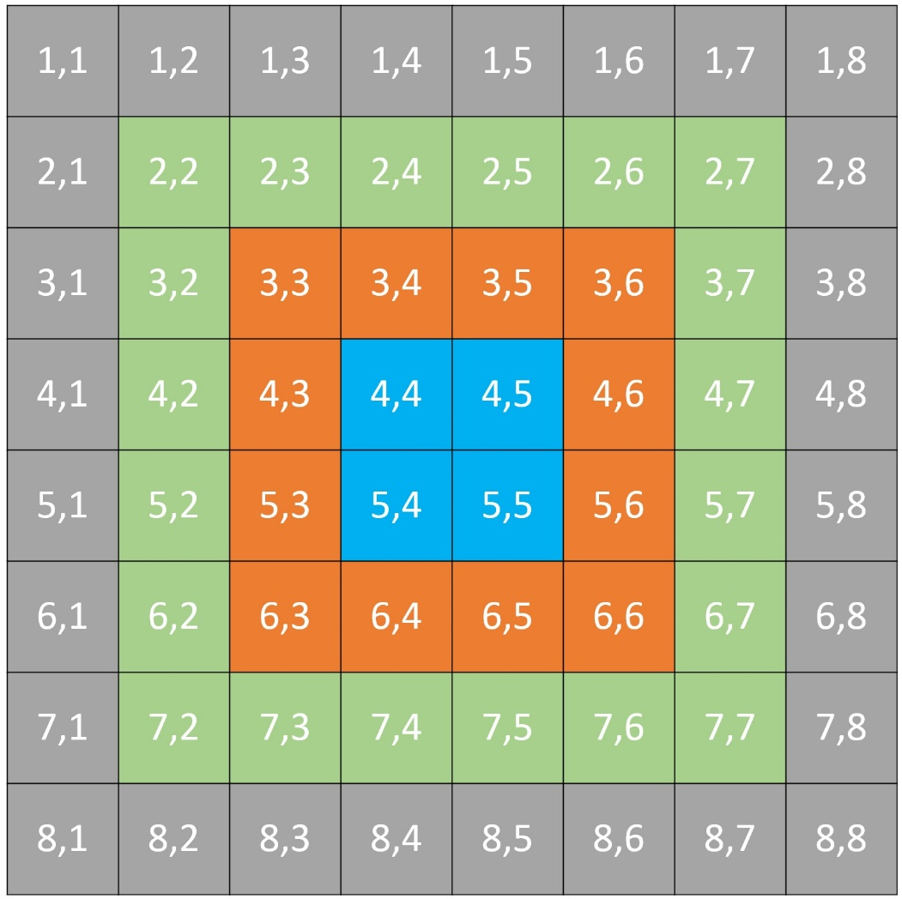
System Implementation (Creating the holes)
Notes:
All blocks in domain pool -> indexed as follows, with each individual square representing a pixel
Current lit -> holes created in photoshop like programs

Slide 8
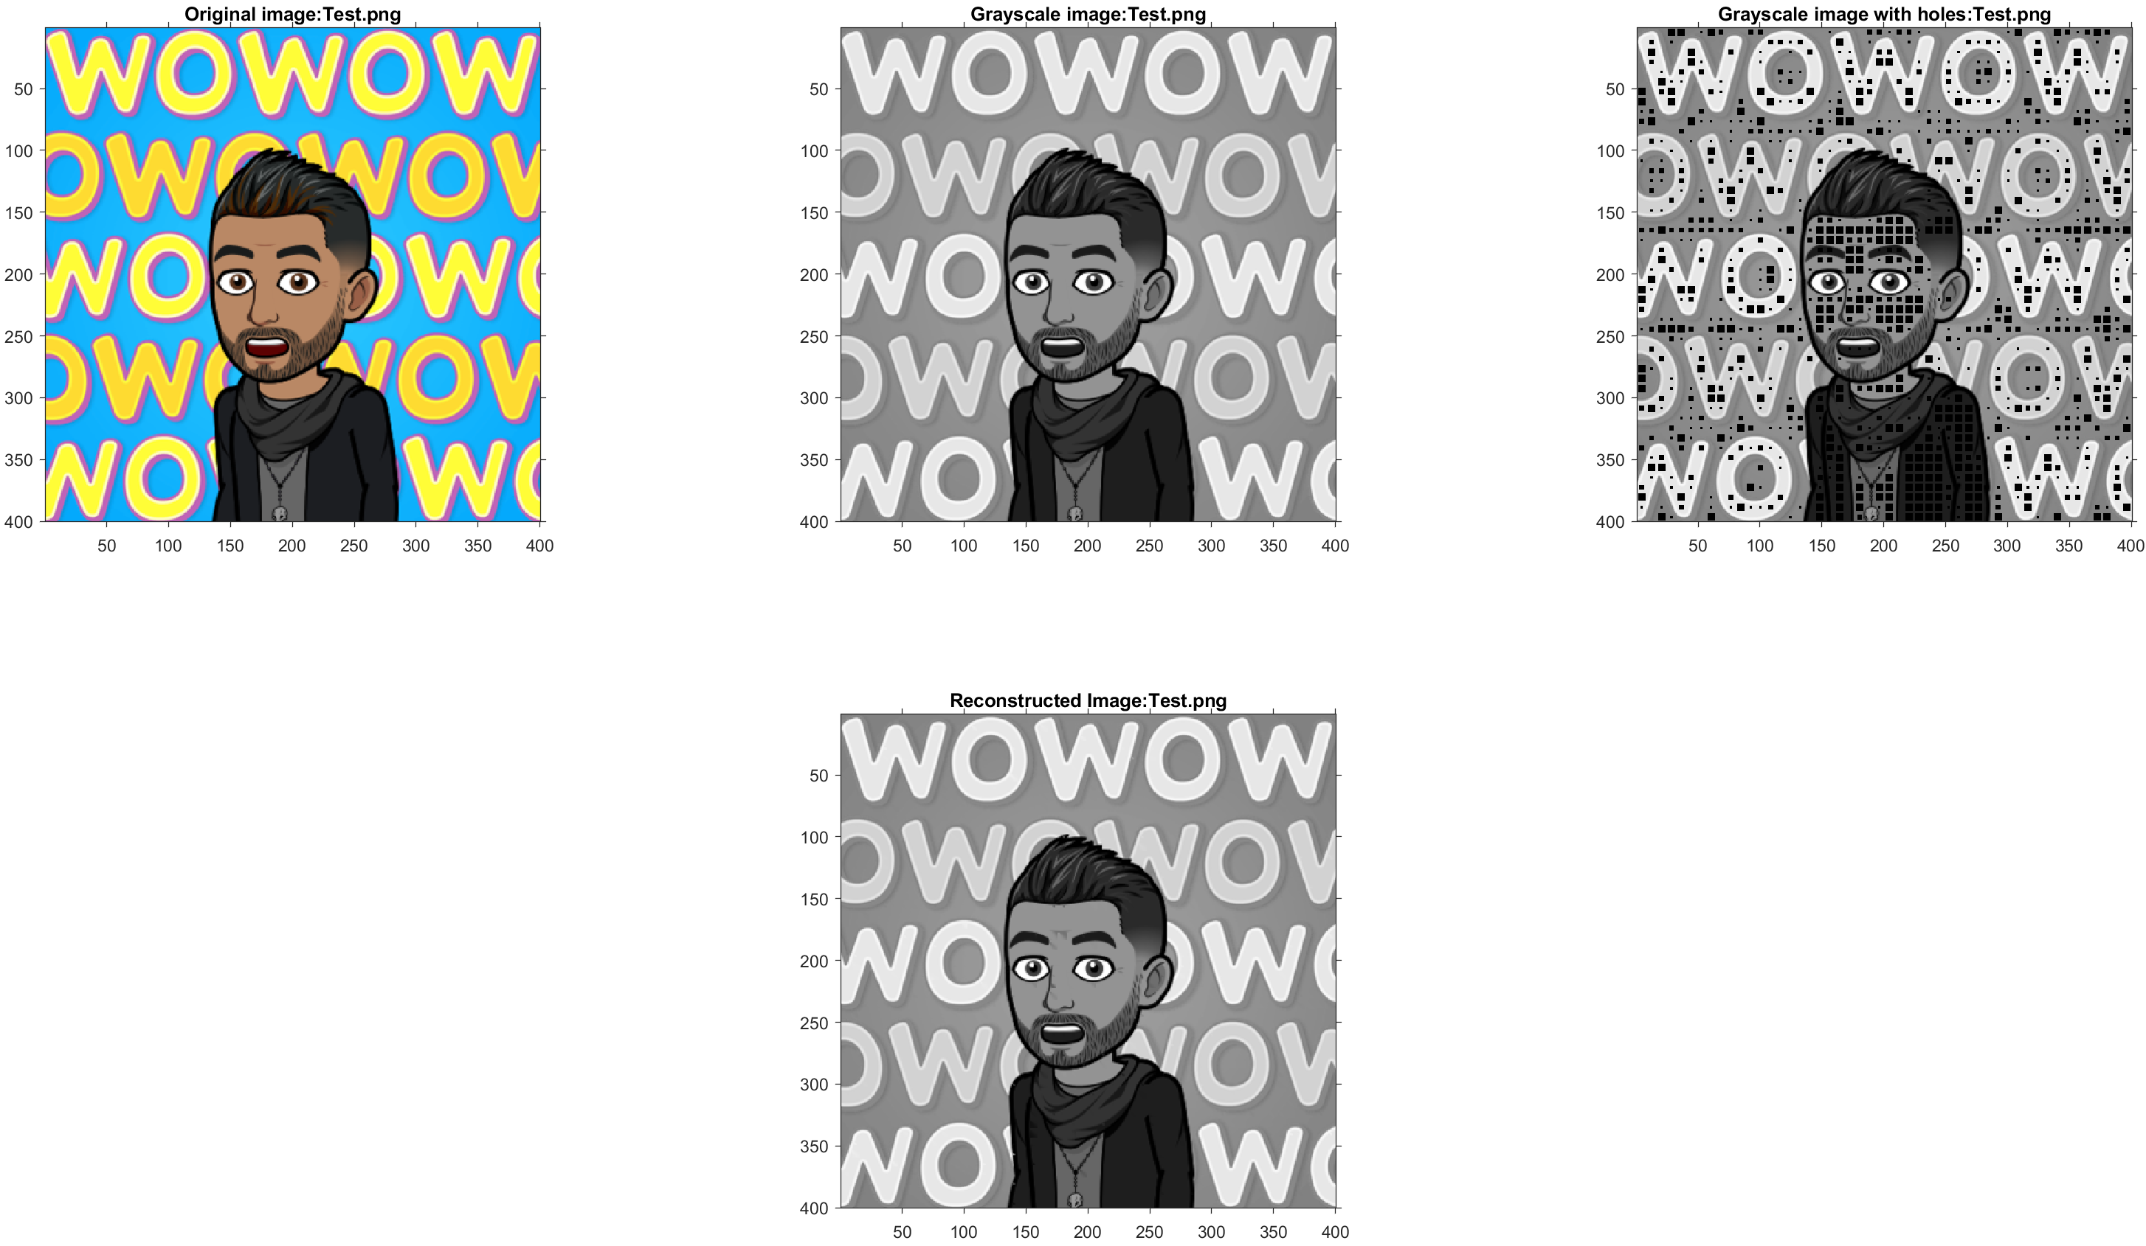
Chebyshev Distance = 1
Notes:
10 simulations run, ranging values from 1 to 10
1 -> too few holes created, even though the final image = near perfect reconstruction

Slide 9
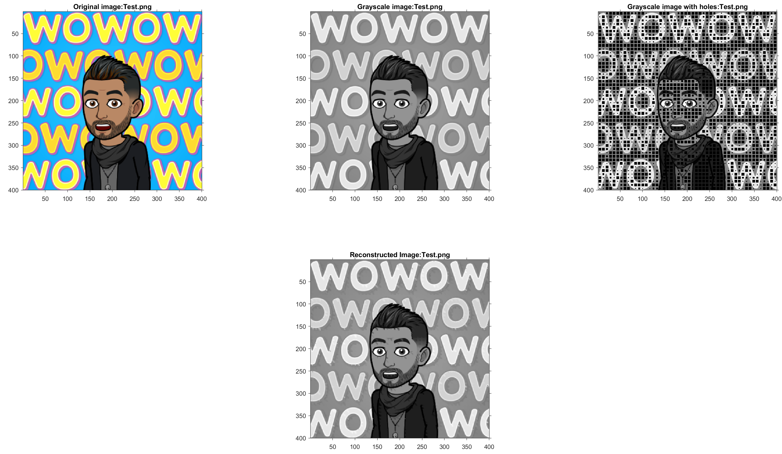
Chebyshev Distance = 10
Notes:
Value of 10 created significantly more holes
Reconstructed image -> too many noticeable differences

Slide 10
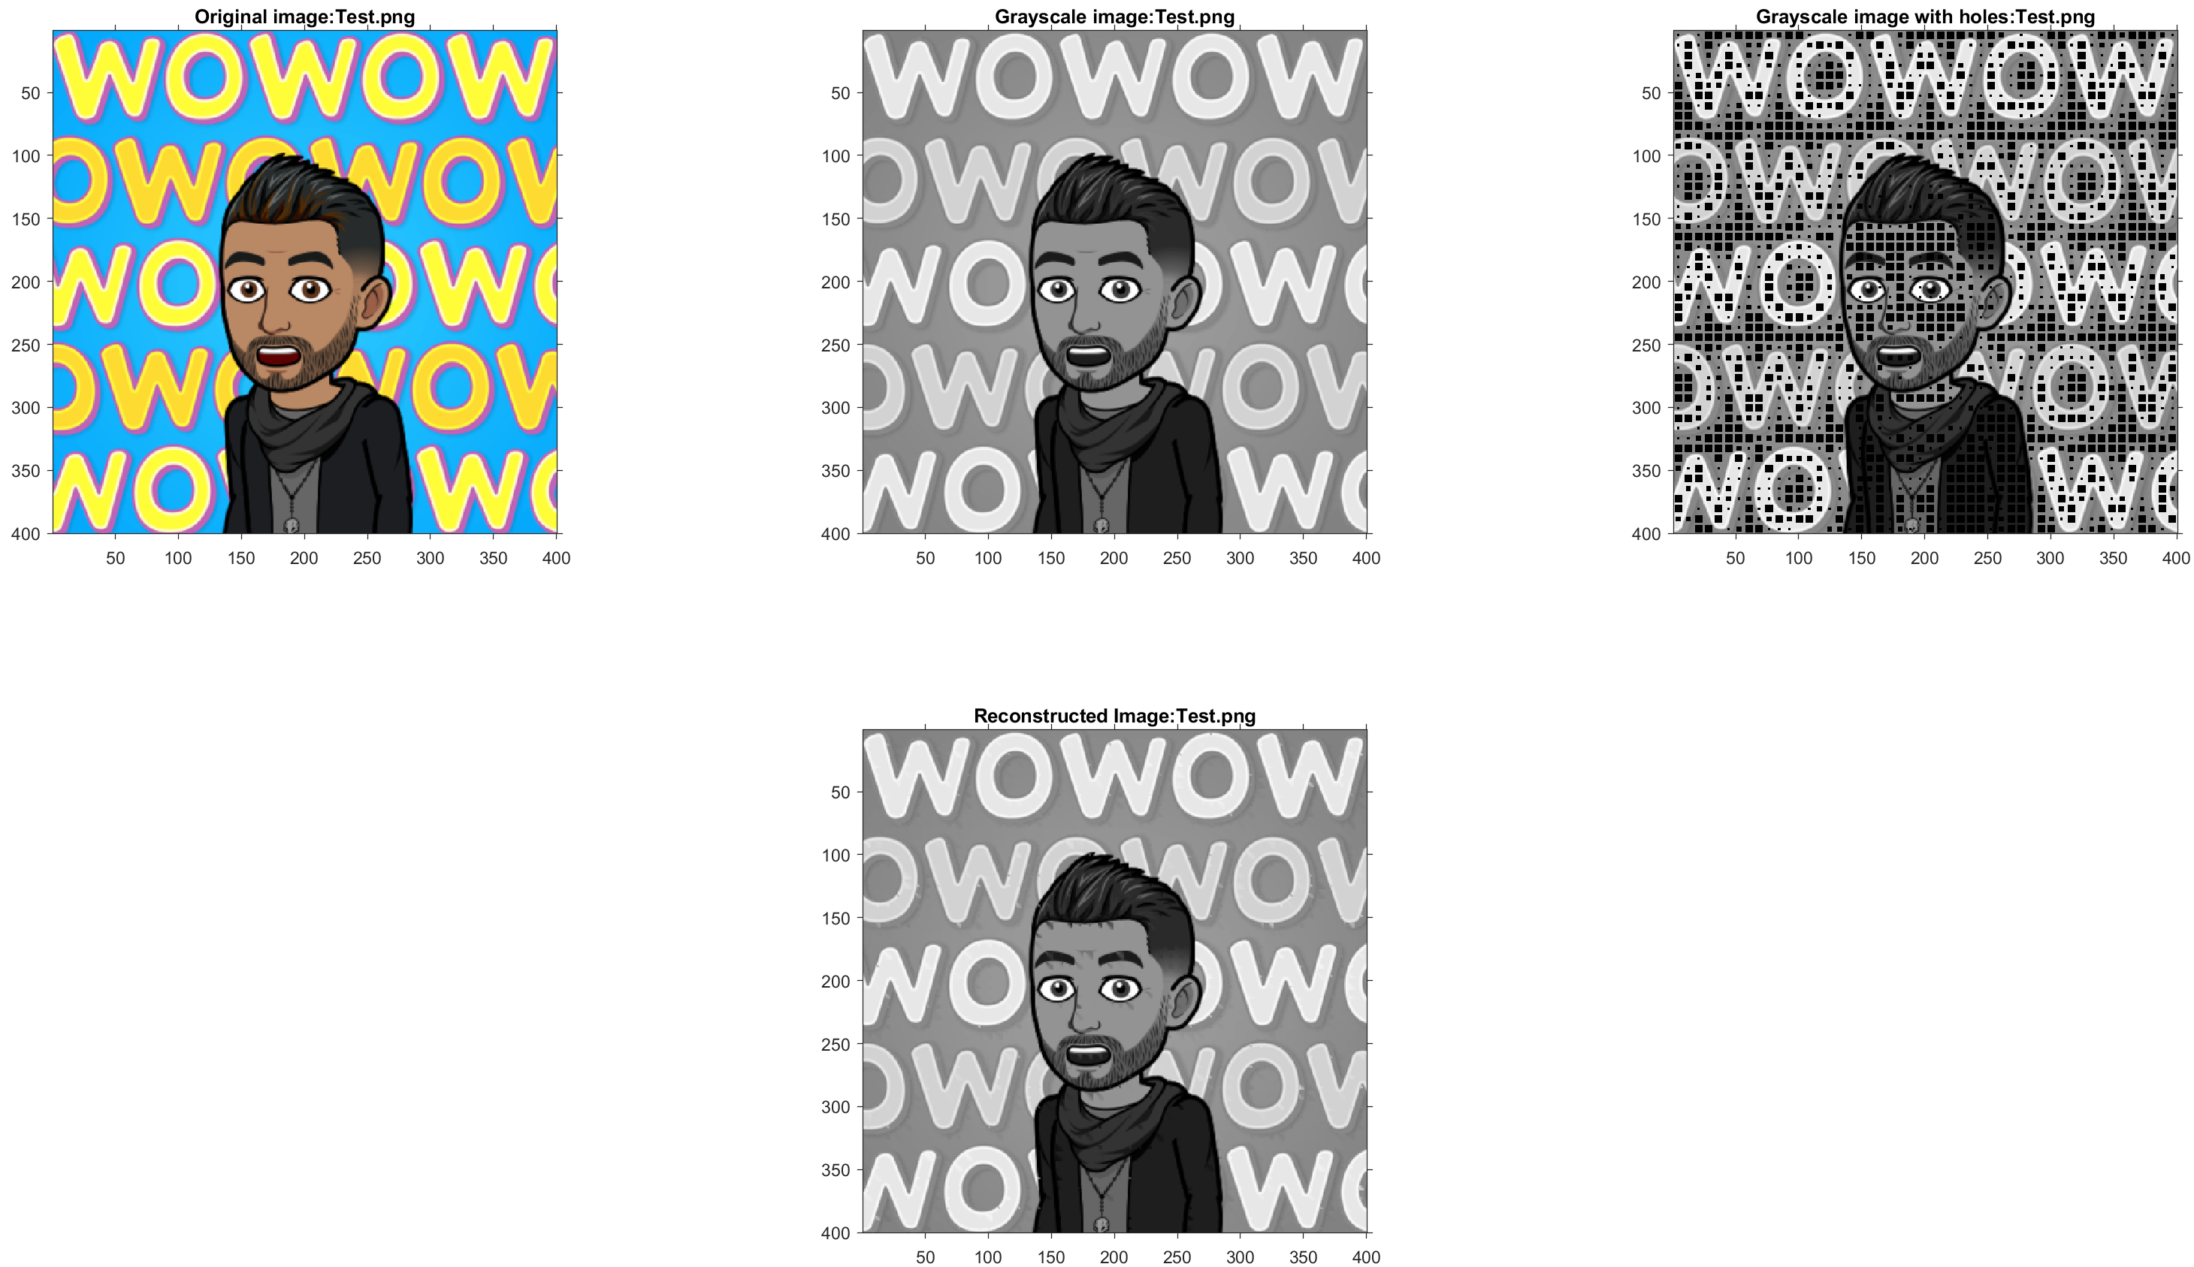
Chebyshev Distance = 6
Notes:
Relevant number of holes
Reconstructed image -> decent reconstruction and allowable amount of difference

Slide 11
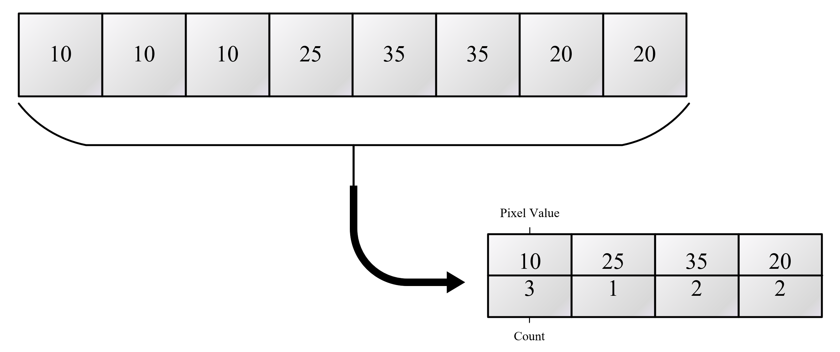
System Implementation (Encoding)
Run Length Encoding
10 → 0000 1010
10 → 1010
Notes:
RLE -> each row in domain pool blocks
2 data sets
RLE -> performs well -> repetitive data (repeating colours)
Smooth transitions -> differences of 1 > performs poorly
8 bits used -> only convert necessary bits

Slide 12


System Implementation (Error Introduction)
Bit flip
62 → 11 1110
Fourth bit to be flipped
11 1010 → 58
Ones Compliment
62 → 11 1110
Ones compliment
00 0001→ 1
Notes:
Both -> random probability of error
Assumption -> value not count affected
Bit flip affect
Images show discrepency

Slide 13
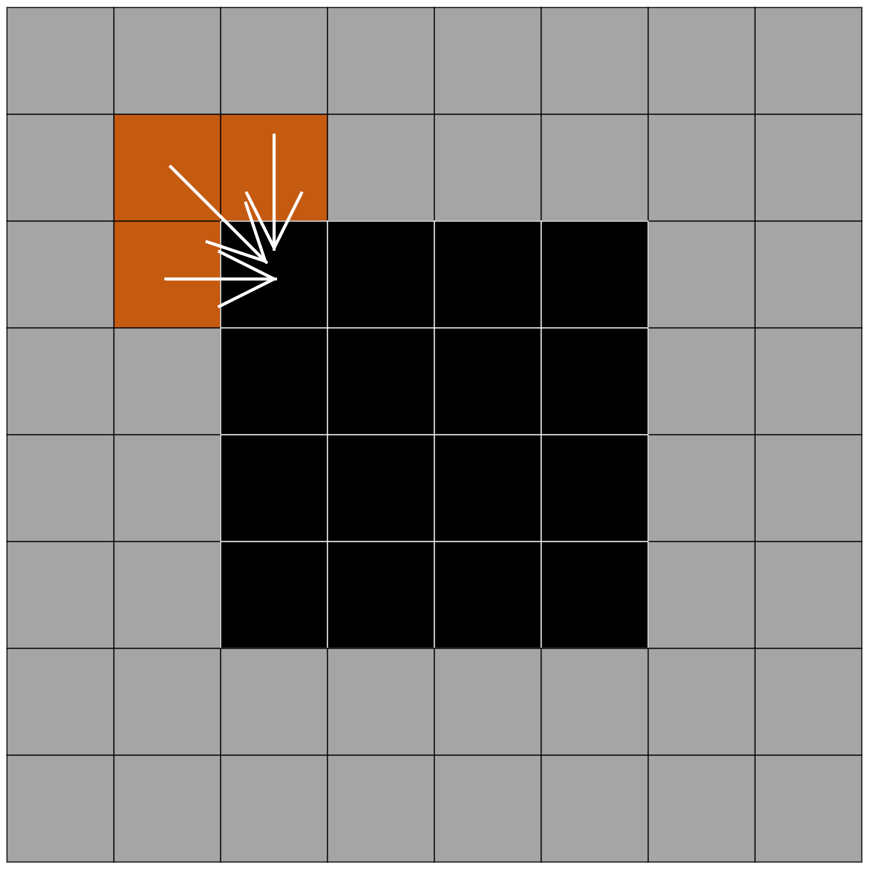
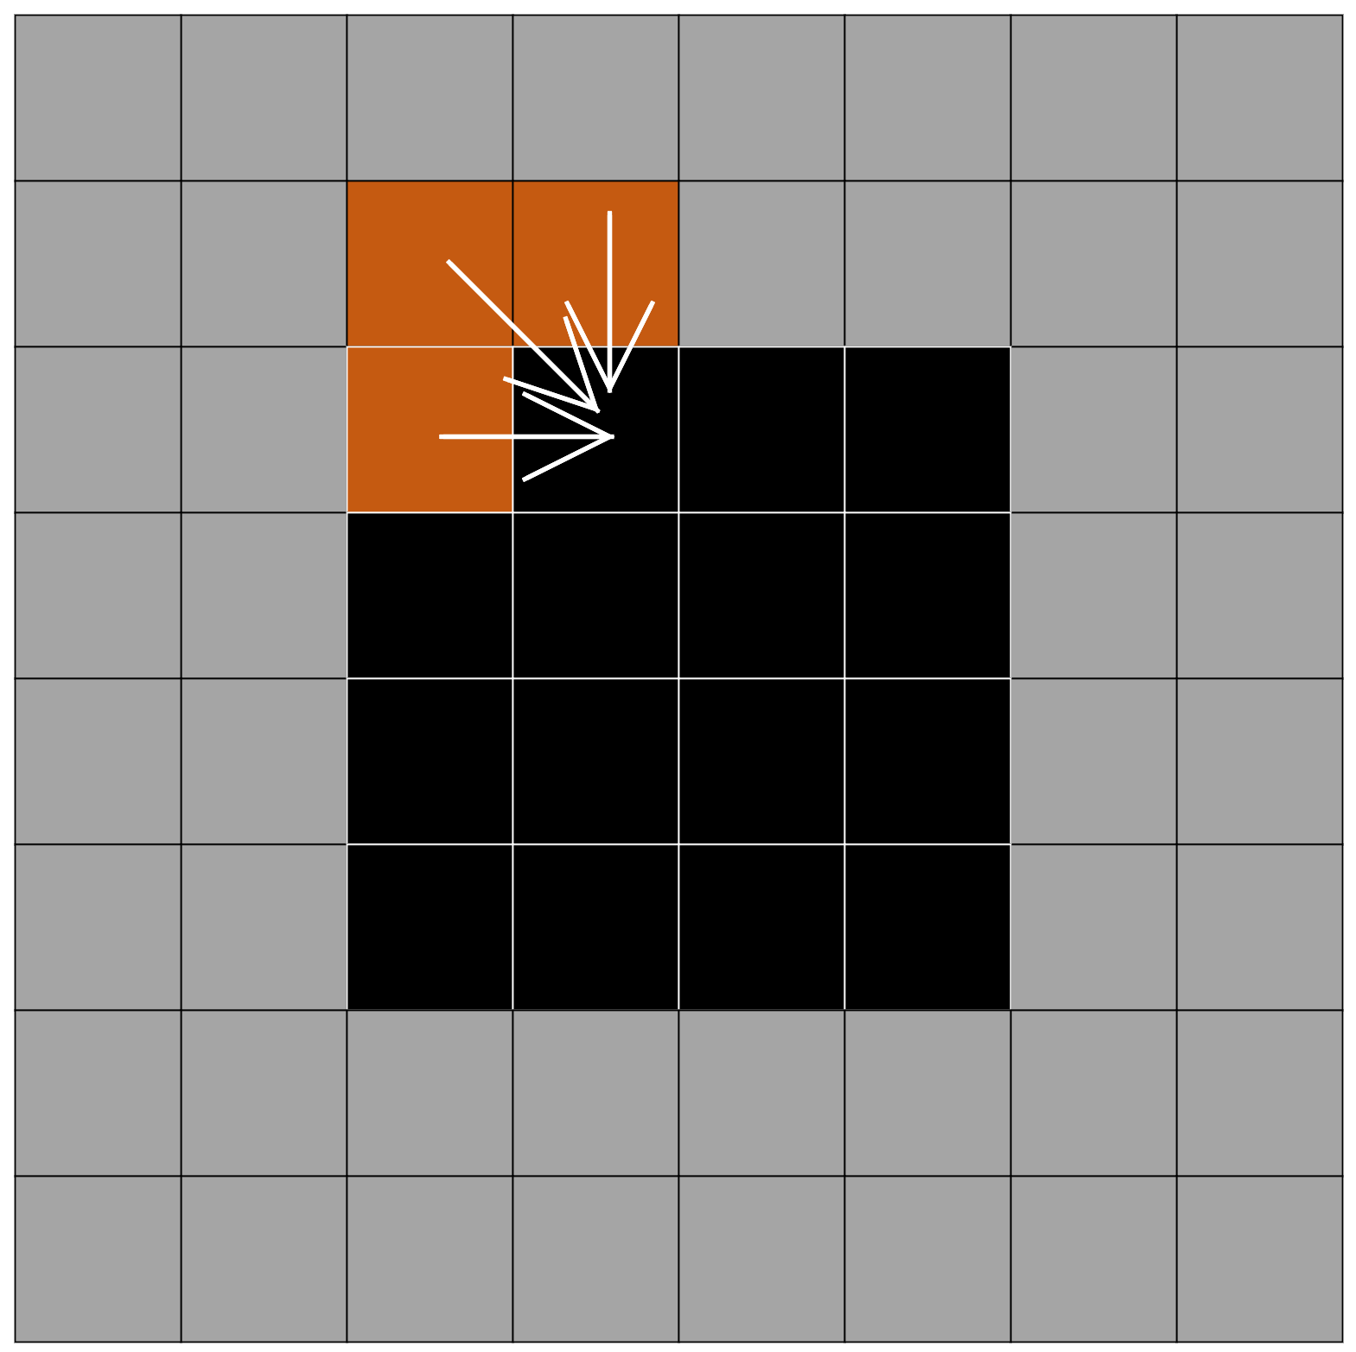
System Implementation (Filling the Holes)
Current literature → pattern matching
Created method → averaging method
Notes:
Since non parametric sampling is used -> redo Chebyshev check to determine if a hole is present

Slide 14

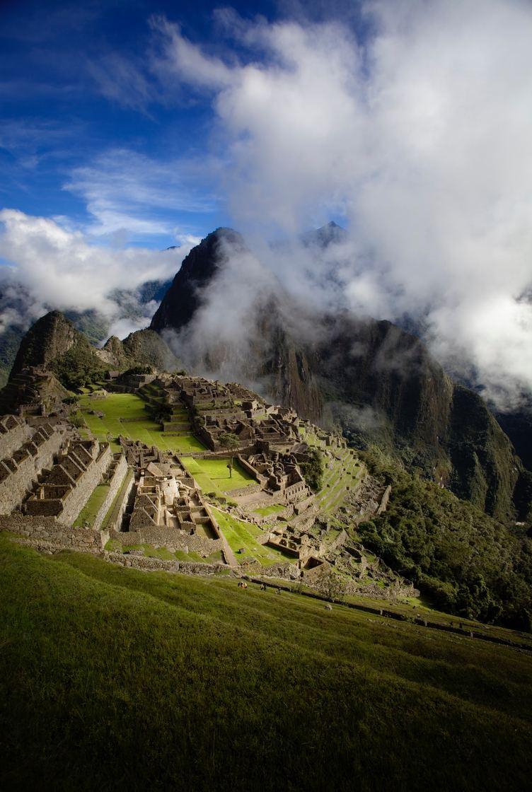
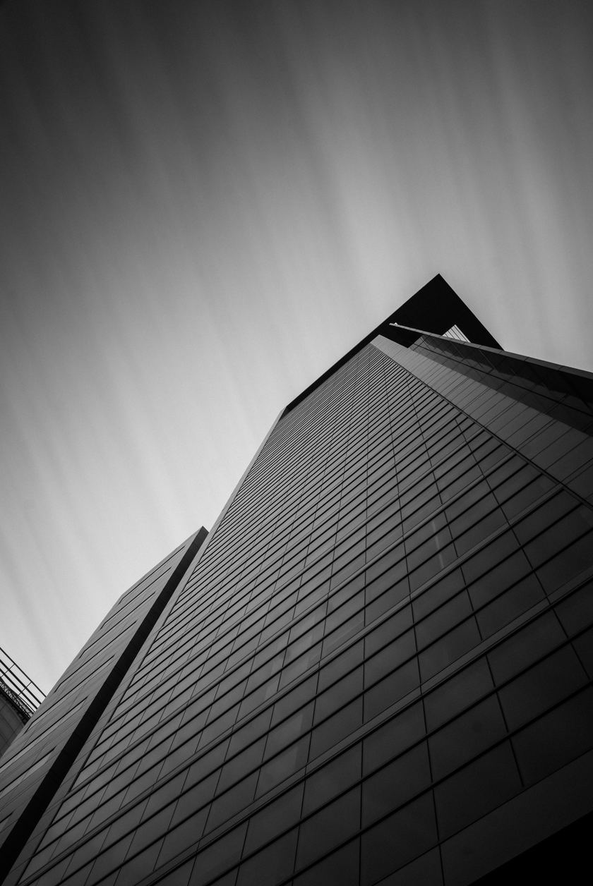
Results & Analysis
Pattern
Landscape
High Contrast
Notes:
3 image types.
Pattern, Landscape, High contrast.
Repetitive colour, levels of detail, edges.

Slide 15


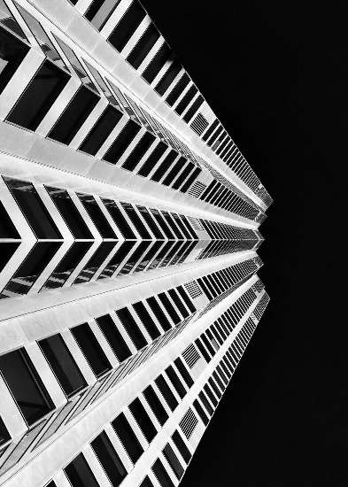

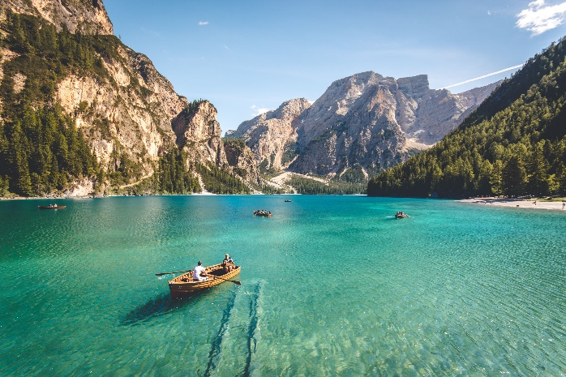

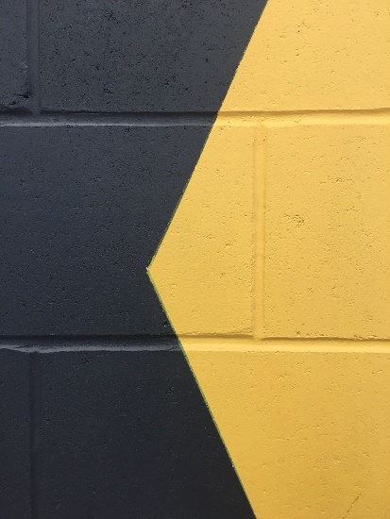

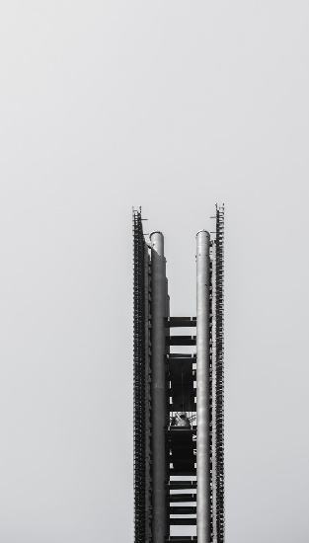
Images used for Testing
Pattern
Landscape
High Contrast
Notes:
4 tests cases were completed on a multitude of images of the various types

Slide 16
Results (Average Compression Ratio)
Tests:
functionality of Holes-only
Average image size:
1200x800 pixels
Chance of errors being introduced:
0% (No errors)
Notes:
Functionality of the holes algorithm.

Slide 17
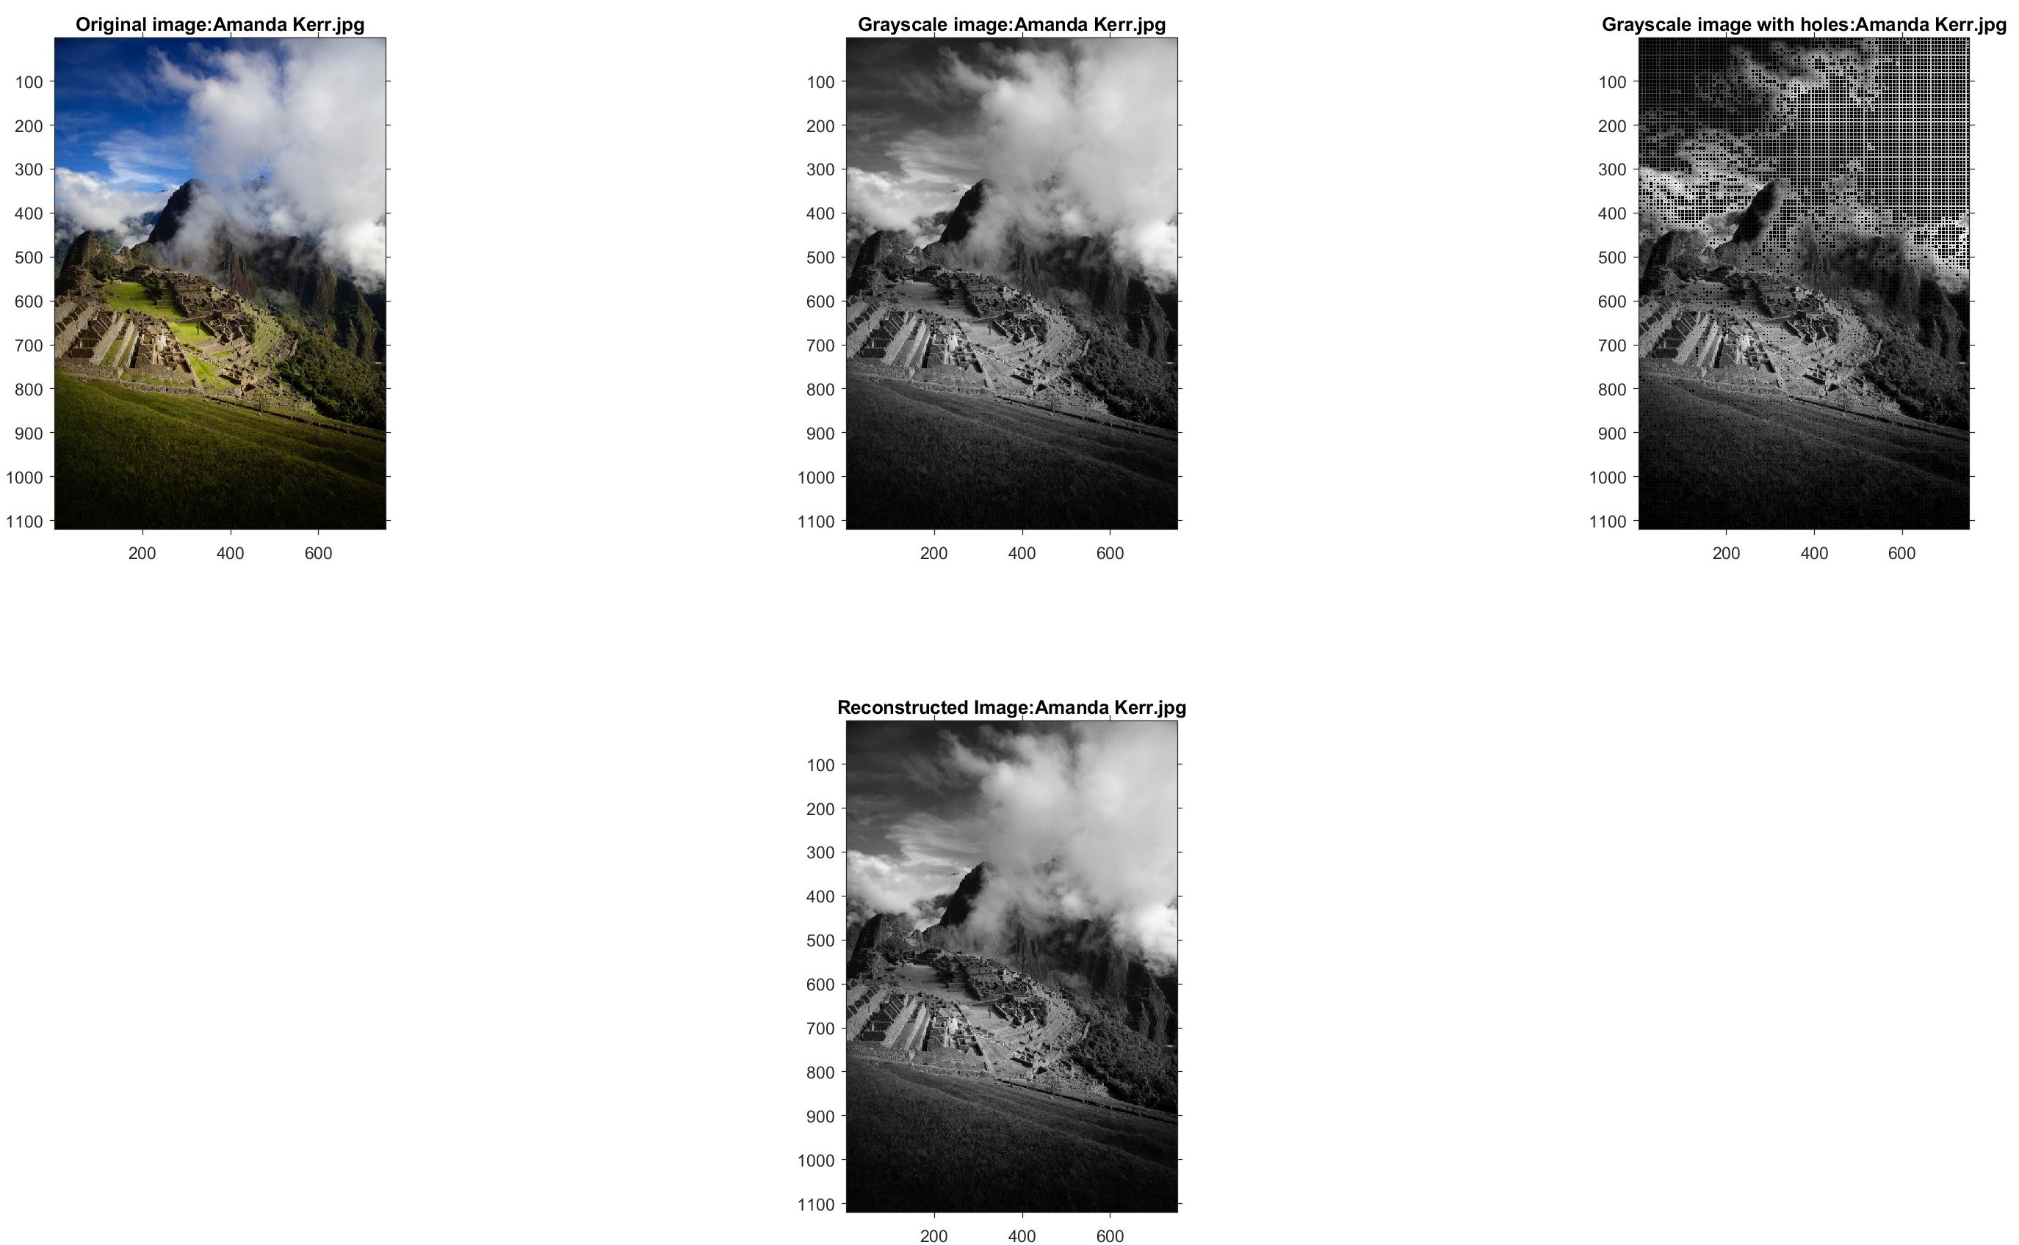
Step-by-Step Process on a Landscape Image
Notes:
The results after the algorithm can be seen.
Colour -> Grayscale ->Holes -> Reconstructed.
What can be noticed is that the differences b/w the original and reconstructed is not noticeable to the human eye even though this is a lossy scheme.

Slide 18
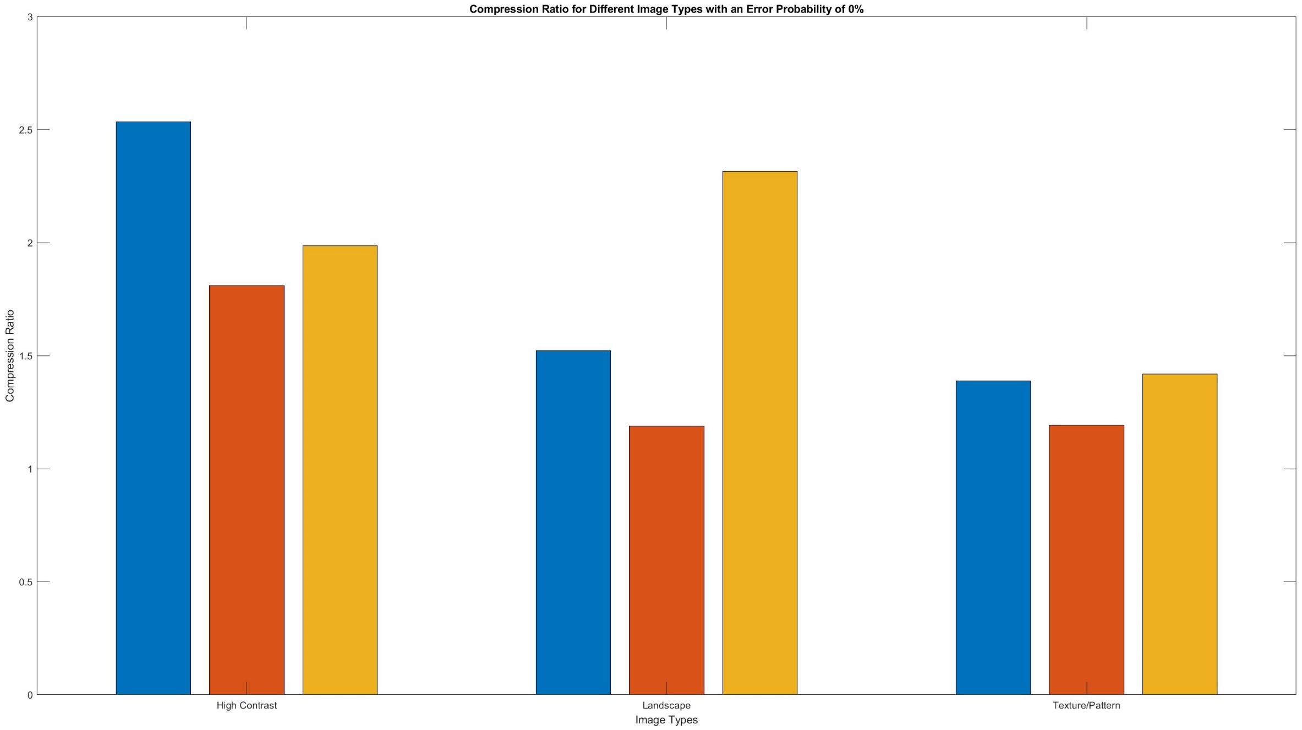
Results (Average Compression Ratio)
Avg = 2.1102
Avg = 1.6753
Avg = 1.3328
Notes:
High contrast highest levels of compression. Repetitive colour of similar shades.
Pattern images lowest CR - > Smooth transitions b/w neighbouring pixels.

Slide 19
Results (Same Image at Different Resolutions)
Tests:
effect of Holes-only algorithm on the compression ratio
Average image size:
2000x1100 pixels
Decreasing in size
Chance of error being introduced:
10%
Bit flip
Notes:
Compression ratio at various resolutions.
Larger the image, the greater the compression ratio.

Slide 20
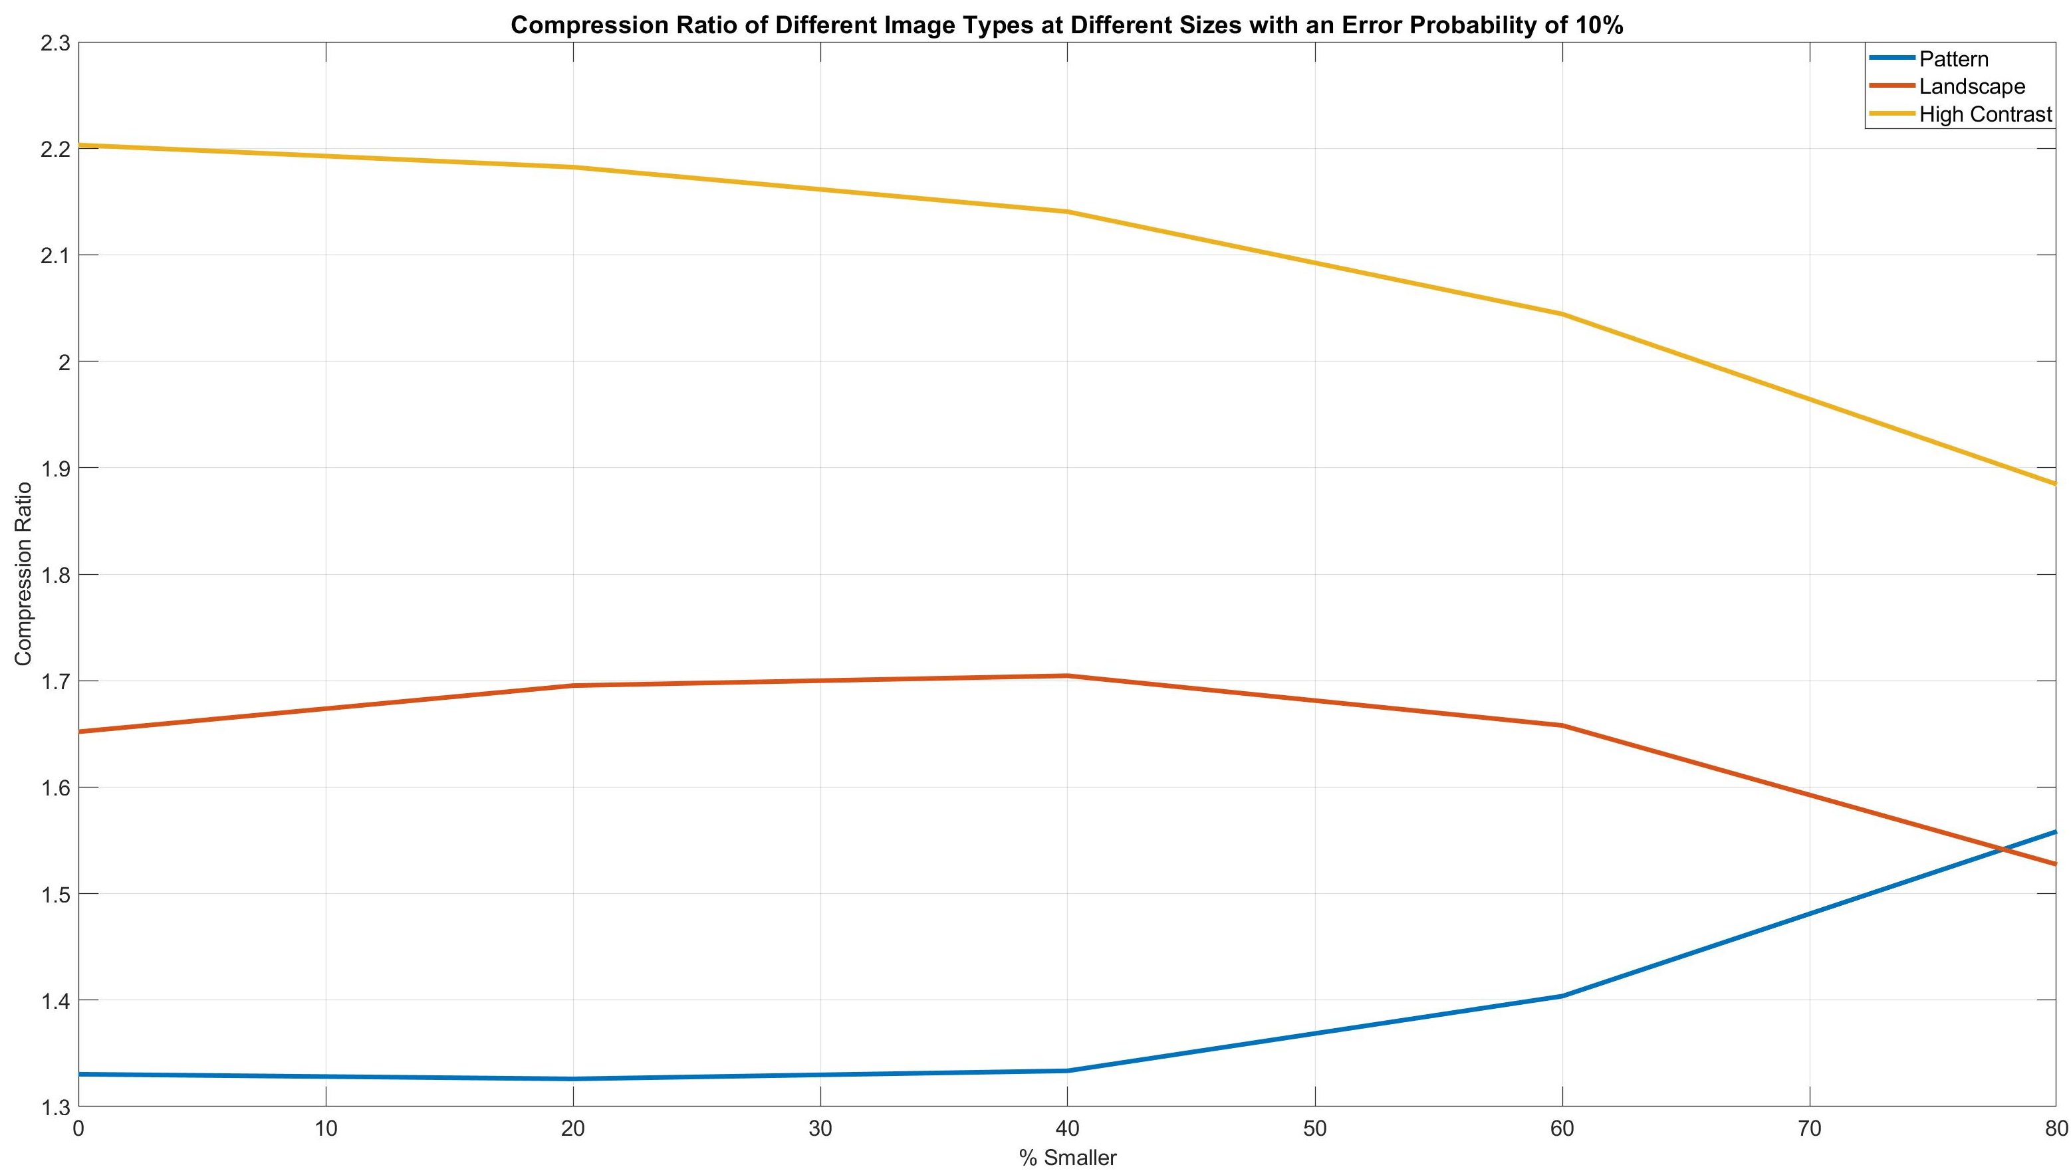
Results (Same Image at Different Resolutions)
Notes:
Smooth transition of colour, the run-length encoding is not efficient for images with these properties.

Slide 21
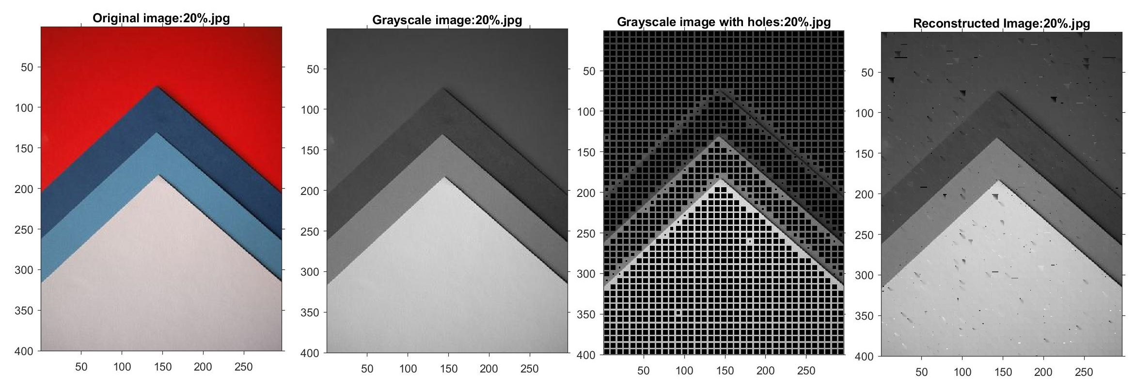
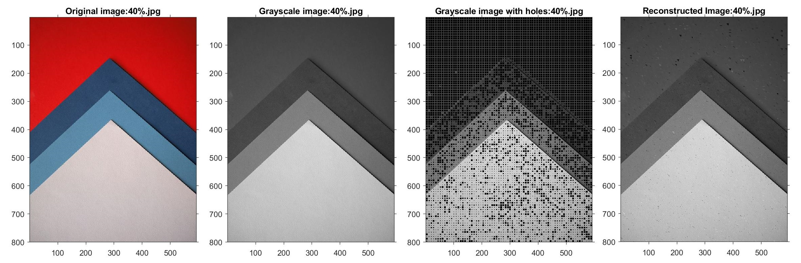

Slide 22
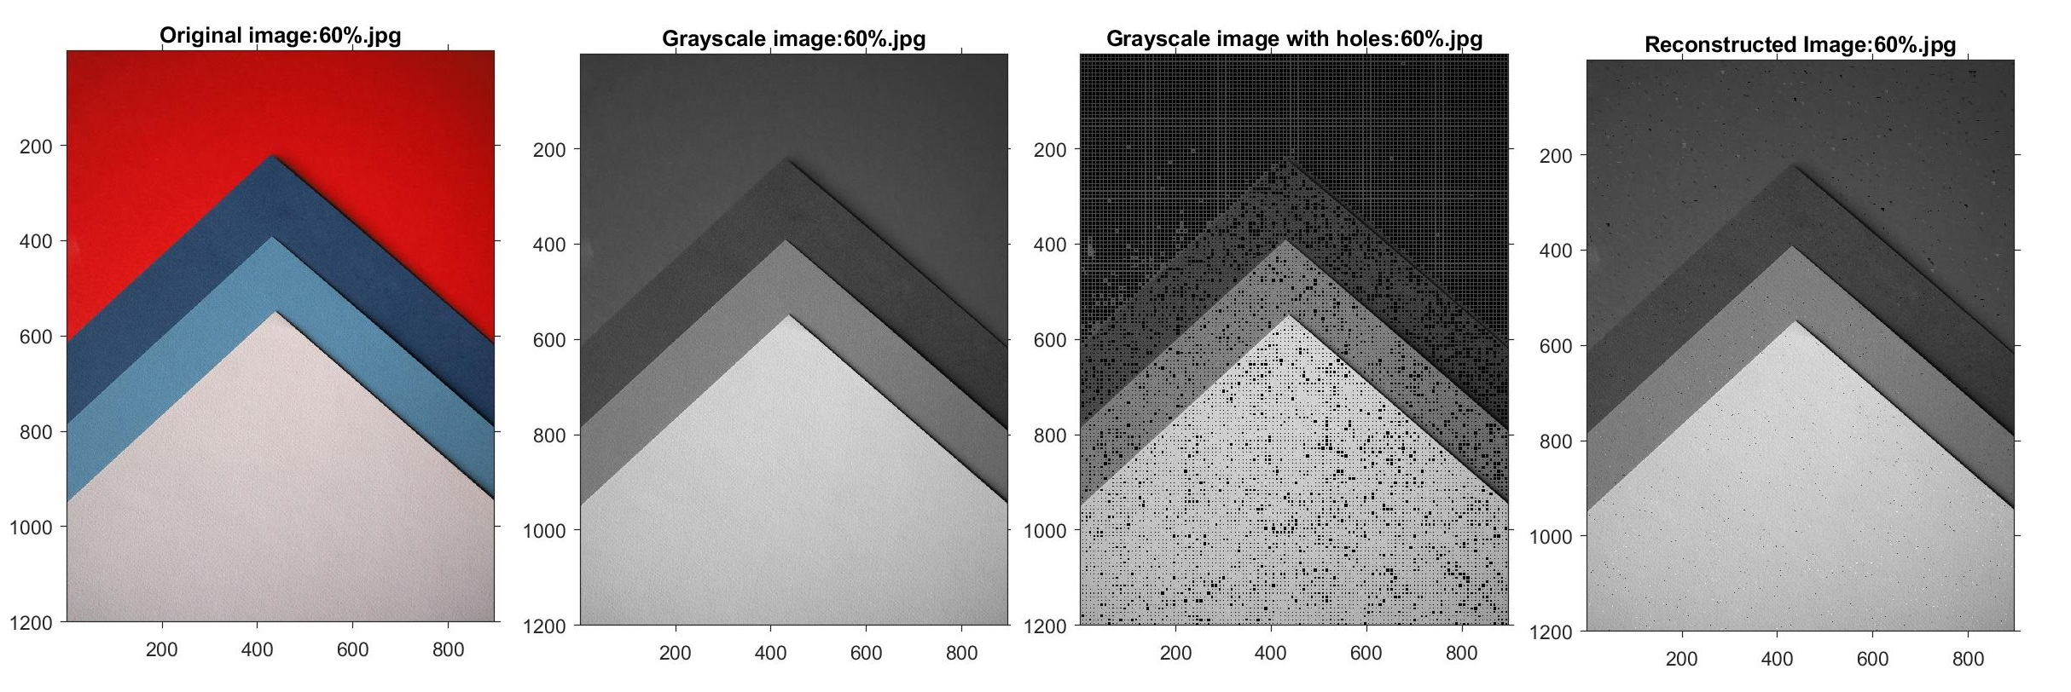
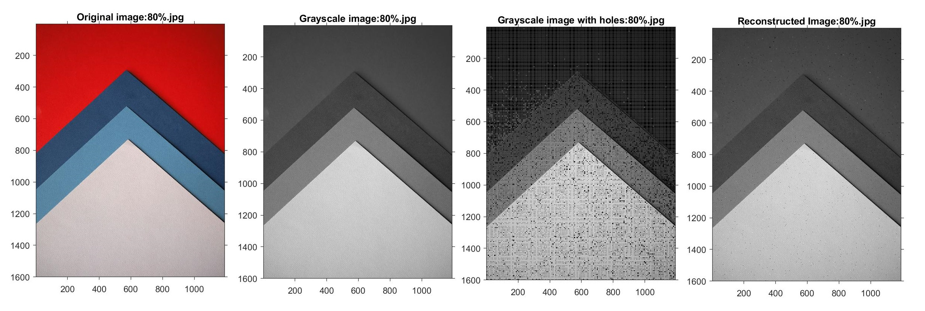

Slide 23
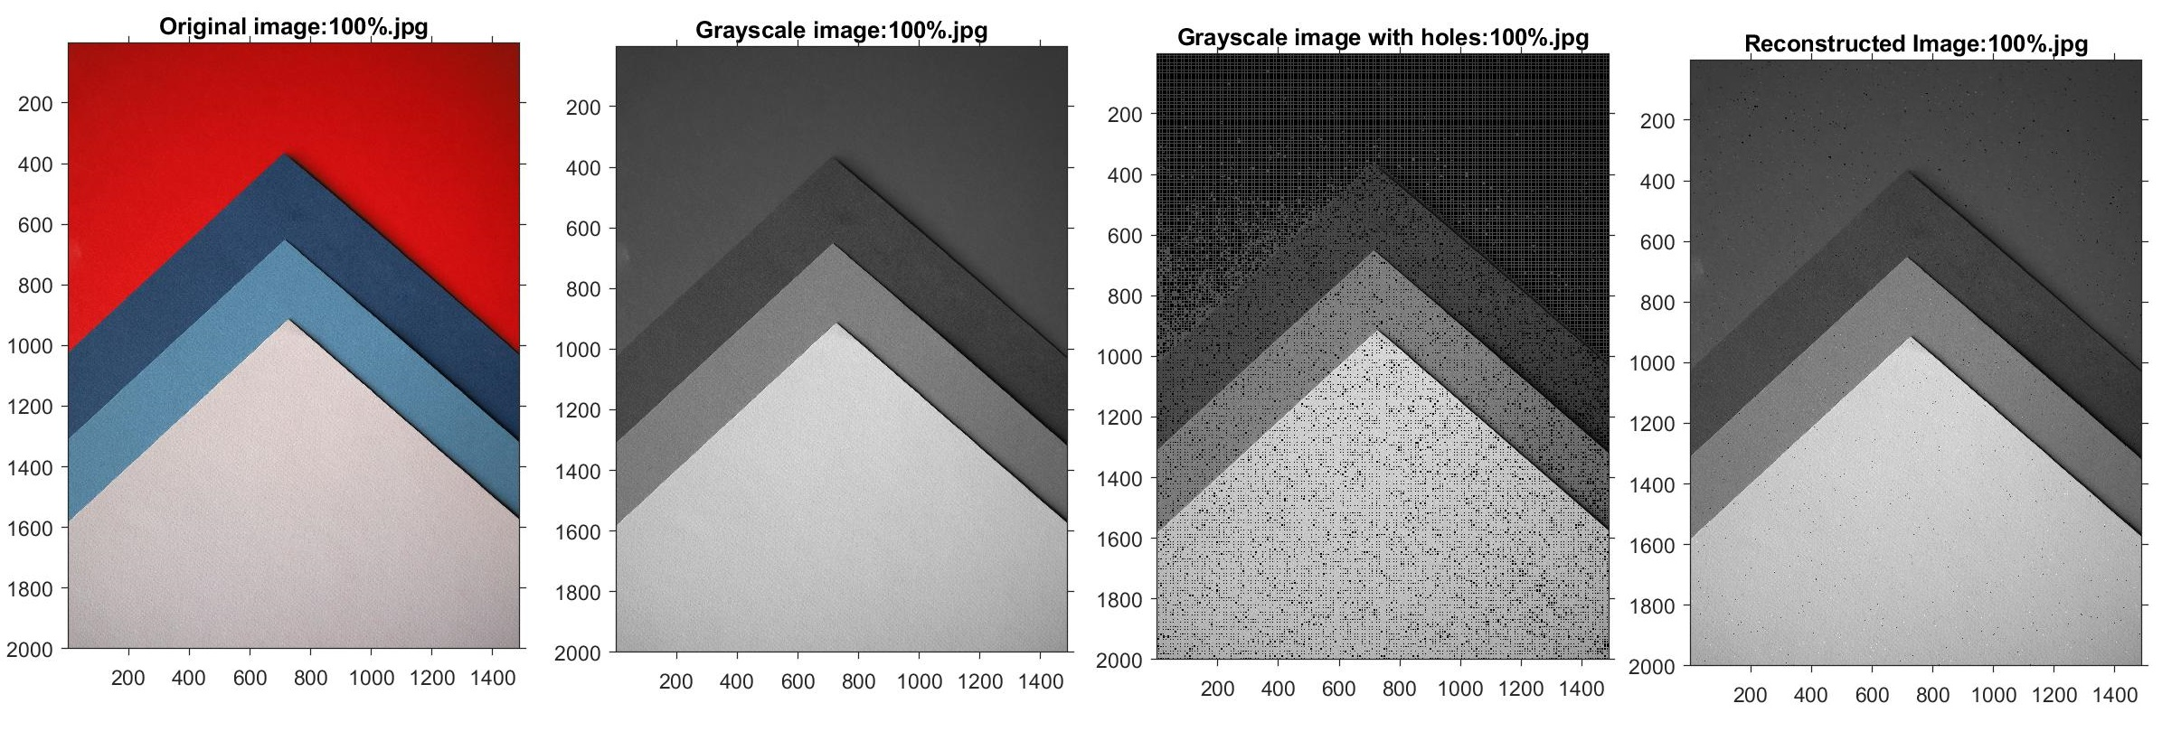

Slide 24
Results (PSNR & MSE)
Tests:
effect of increasing error probability on different image types
Average image size:
1200x800 pixels
Chance of error being introduced:
Increasing from 0% to 100%
Bit flip and Ones compliment introduction
Notes:
Effect of increasing errors on an image.
Predicted that as the error probability increases, so should the MSE.
PSNR – identify perceived errors noticeable by human vision.

Slide 25
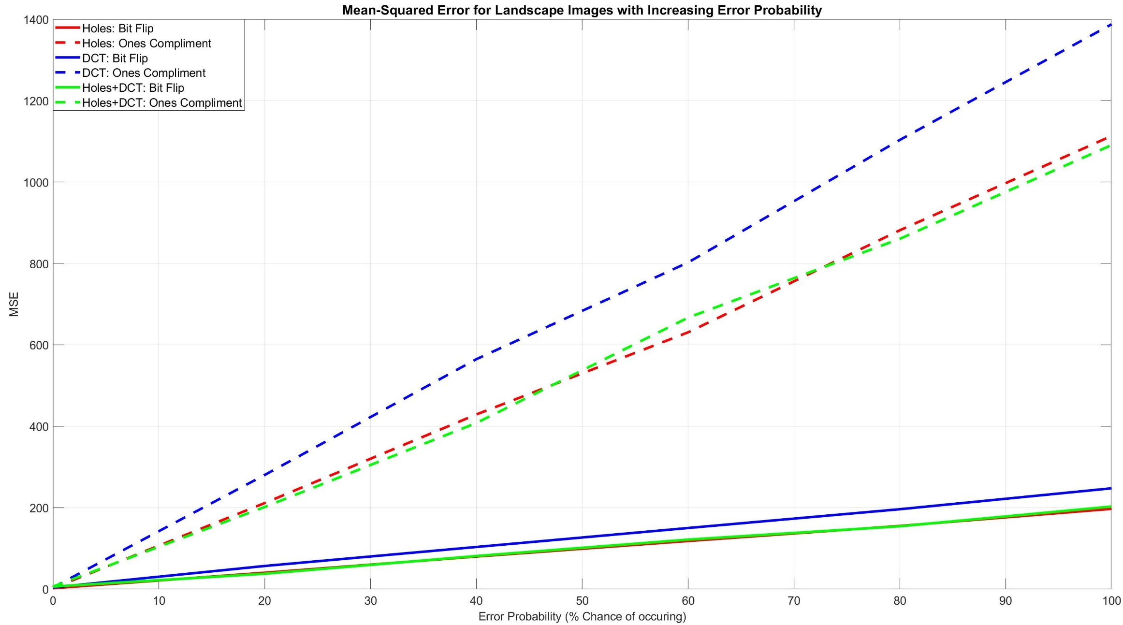
Results (MSE)
Notes:
Predicted that as the error probability increases, so should the MSE.
PSNR – identify perceived errors noticeable by human vision.

Slide 26
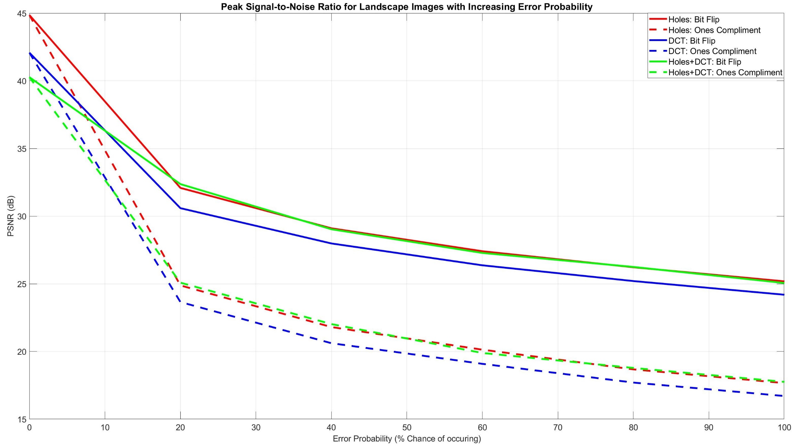
Results (PSNR)

Slide 27
Results (Comparison with DCT & DWT)
Tests:
How does the holes only algorithm perform against DCT and DWT technique
Image size:
Known images
Chance of error being introduced:
10%
Bit flip introduction

Slide 28
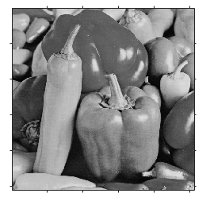
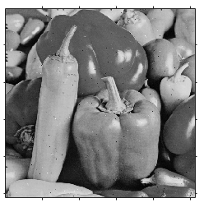
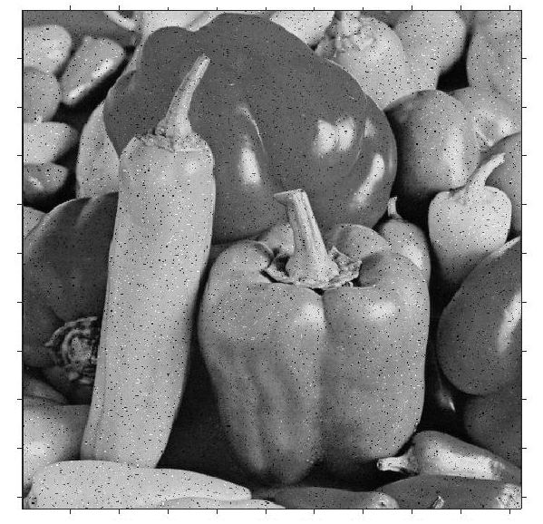
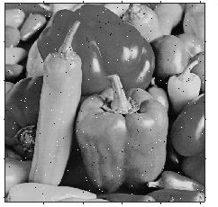
Results (Comparison with DCT & DWT)
Averaged Results with 10% Error
Method | Compression ratio | PSNR | MSE
Holes | 1,15 | 33,20 | 31,71
DCT | 1,09 | 53,02 | 225,81
DWT | 2,57 | 25,22 | 244,60
Peppers: Original
Peppers: Holes
Peppers: DCT
Peppers: DWT

Slide 29
Future Work
Serial programming used → long processing time
Parallel programming
Run Length Encoding → drawbacks
Better encoding scheme
Distance value of 6 → hard coded values
Neural networks (GAN)
Lower resolution → higher resolution
Notes:
Applications similar to that of the Generative adversarial network.

Slide 30
Conclusion
All objectives met within project specifications
Created algorithm:
Functional image compression scheme
Maintains image quality
All images from Unsplash.com

Slide 31
Thank You!
Kishan Narotam Nitesh Nana
Supervisor: Professor Fambirai Takawira

